Slide 1
CAN ID
---- FX ----
Drive Right 1 = 1
Drive Right 2 = 2
Drive Left 1 = 3
Drive left 2 = 4
Shooter Top = 5
Shooter Bottom 6
--- Victor -----
Elevator = 7
Intake = 8
Conveyer = 9
Light= 10
Climber winch lock = 11
--- FX ----
Climber = 12
Pneumatics ShootGate = 2;
Pneumatics ShootPush = 3;
Pneumatics Intake = 1;
Pneumatics Shift = 0;

Slide 2
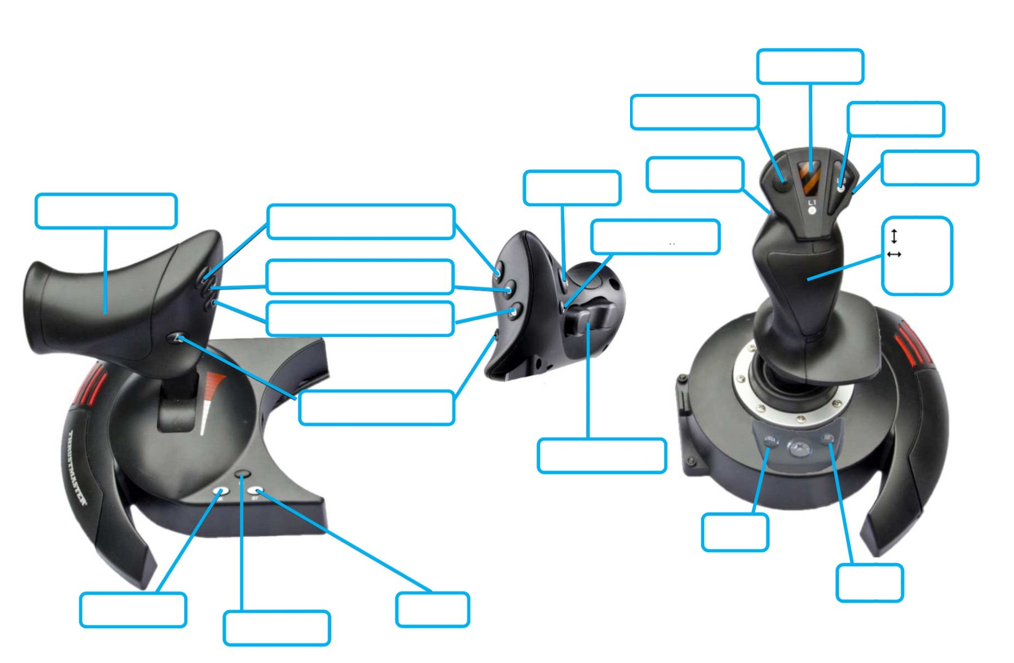
Sweeper up
Not used
Climb override
High Gear
Auto Align
Auto Align
Climb
Sweeper intake
Climb safety
forward
Conveyer (override)
turn
Not used
Shoot
Adjust shooter range
Not used
Not used
Unlock Climb
Lock climb
Not used

Slide 3
Front
Compressor
RoboRio
PCM
Ball shoot
sweep
VRM
Ball gate
shift
elevator
lock
sweep
conveyer
light
PDP
battery

